Slide 1
Online Role-based training resources: Microsoft Learn https://docs.microsoft.com/en-us/learn/

Slide 2
Module 1: Getting Started with Microsoft Data Analytics

Slide 3
Learning Objectives
You will learn the following concepts:
Data Analysis
Getting Started with Power BI
Notes:
By the end of this module, you’ll be able to:
Understand data analysis
Get started with Power BI

Slide 4
Module Agenda
Data Analytics and Microsoft
Getting Started with Power BI

Slide 5
Lesson 1: Data Analytics and Microsoft

Slide 6
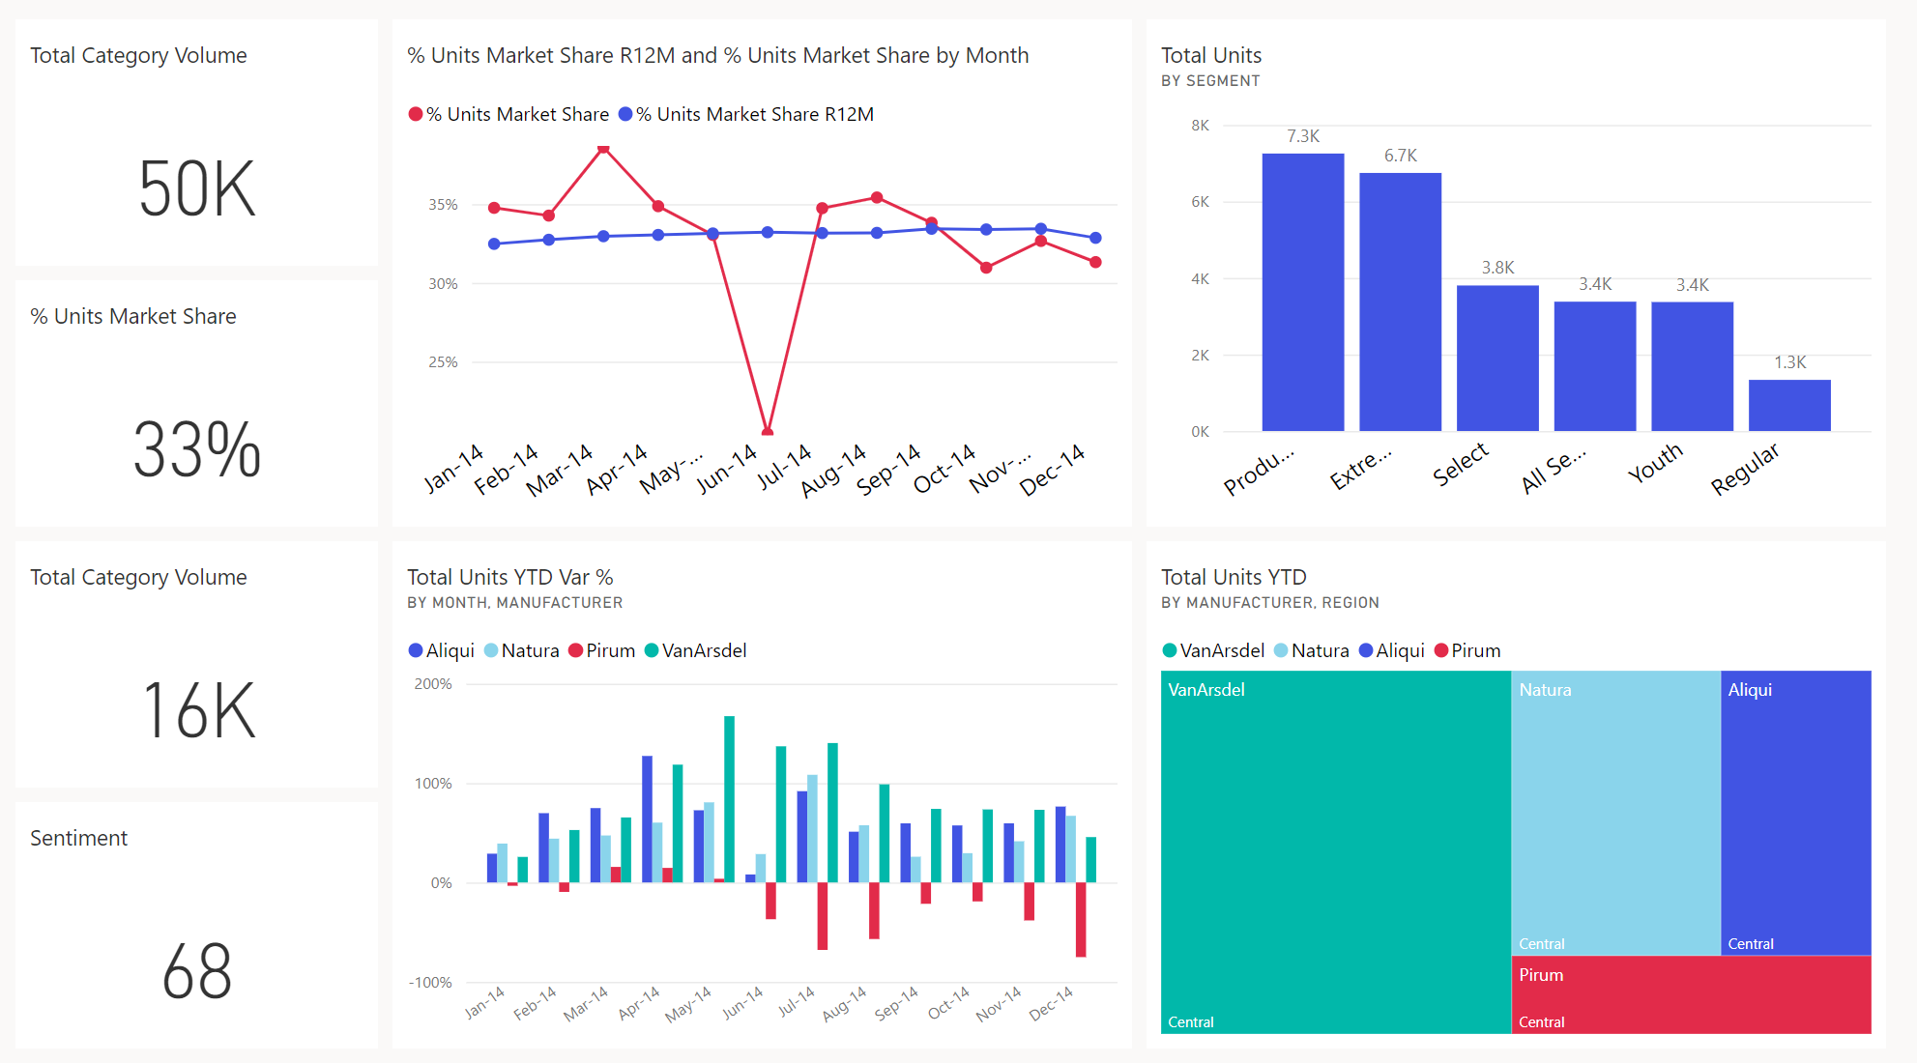



















Introduction
Data and information is the most strategic business asset.
Notes:
As a data analyst, you are on a journey. Think about all the data that is being generated each day and that is available in an organization, from transactional data in a traditional database, telemetry data from services you use, to signals you get from different areas like social media.
Businesses of today collect and store massive amounts of data. Yet, businesses continue to struggle to use their data in a meaningful and productive way, which impacts their ability to act. Business should be able to use their vast amounts of data and information in such a way that impacts the business.
Business decision makers depend on an accurate story to drive better business decisions. The faster a business can make precise decisions, the more competitive they will be and the better advantage they will have.
The key to unlocking all this data is being able to tell as story with it via compelling and insightful reports.
Your journey of telling a story with data also ties into building that data culture within your organization. While telling the story is important, where that story is told is also crucial, making sure the story is told to the right people.

Slide 7
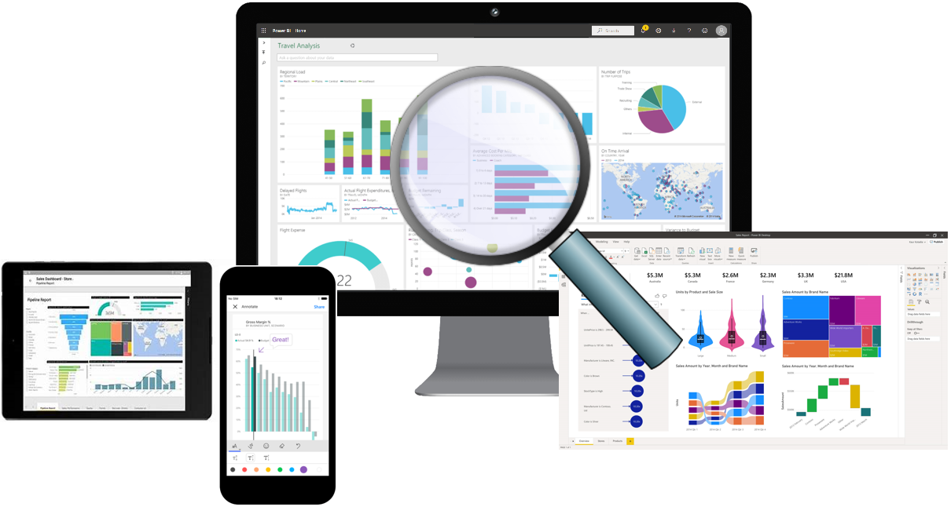
Overview of Data Analysis
Data Analysis is telling a story with data.
Five categories of analytics:
Descriptive
Diagnostic
Predictive
Prescriptive
Cognitive
Notes:
Before data can be used to tell a story, it must first be run through a process that makes it usable in the story. Thus, data analysis is the process of identifying, cleaning, transforming, and modeling data to discover meaningful and useful information. The data is then crafted into a story via reports for analysis to support the critical decision-making process.
While the process of data analysis focuses on the tasks of cleaning, modeling, and visualizing data, the concept of data analysis and how it is important to business should not be understated. To analyze data, core components of analytics are divided in the following categories:
As the world becomes more data-driven, storytelling through data analysis is becoming a more vital component and aspect of businesses large and small and is the reason organizations continue to hire data analysts.
Data-driven businesses make decisions based on the story their data tells, and in today's data-driven world, data is not being used to its full potential, a challenge that most business face today. Data analysis is and should be a critical aspect of all organizations to determine the impact to their business, including customer sentiment, market and product research, identify trends, or any other data insights.
Descriptive: Descriptive analytics helps answer questions about what has happened, based on historical data. Descriptive analytics techniques summarize large datasets to describe outcomes to stakeholders.
Diagnostic: Diagnostic analytics techniques supplement more basic descriptive analytics. They take the findings from descriptive analytics and dig deeper to find the cause. The performance indicators are further investigated to discover why they got better or worse.
Predictive: Predictive analytics techniques use historical data to identify trends and determine if they're likely to recur. Predictive analytical tools provide valuable insight into what may happen in the future.
Prescriptive: By using insights from predictive analytics, data-driven decisions can be made. This technique allows businesses to make informed decisions in the face of uncertainty.
Cognitive: Cognitive analytics helps you to learn what might happen if circumstances change, and how you might handle these situations, derive conclusions based on existing knowledge bases, and then add these findings back into the knowledge base for future inferences, a self-learning feedback loop.

Slide 8
Roles in Data
Business Analyst
Data Analyst (PL-300)
Data Engineer (DP-203)
Data Scientist (DP-100)
Database Administrator (DP-300)
Notes:
As mentioned before, you are not alone. This is a journey and it usually doesn't start with you. The data must come from somewhere. And getting that data into a spot that is usable by you takes some effort and more than likely out of your scope. Especially when we think of the enterprise.
Today's applications and projects can be large and intricate, often utilizing the skills and knowledge of numerous individuals. Each person brings a unique talent and expertise to the table, working together and coordinating tasks and responsibilities in order to see a project through from concept to production.
Business analyst: While there are some similarities between a data analyst and business analyst, the key differentiator between the two roles is what they do with data. A business analyst is closer to the business itself and is a specialist on interpreting the data that comes from the visualization. Often the data analyst and business analyst could be the accountability of a single person.
Data analyst: Data analysts are responsible for profiling, cleaning, and transforming data, designing, and building scalable and performant data models, and enabling and implementing the advanced analytics capabilities into reports for analysis. Data analysts work with data engineers to determine and locate appropriate data sources and identify new processes or improve existing processes.
Data engineer: Primary responsibilities of data engineers include the use of on-premises and cloud data services and tools to ingest, egress, and transform data from multiple sources. They provision and set up data platform technologies that are on-premises and in the cloud. They manage and secure the flow of structured and unstructured data from multiple sources.
Data scientist: Data scientists perform advanced analytics to extract value from data. Their work can vary from descriptive analytics to predictive analytics. Descriptive analytics evaluate data through a process known as exploratory data analysis (EDA). Predictive analytics are used in machine learning to apply modeling techniques that can detect anomalies or patterns. These are an important part of forecast models.
Database administrator: A database administrator implements and manages the operational aspects of cloud-native and hybrid data platform solutions built on Microsoft Azure data services and Microsoft SQL Server. They are responsible for the overall availability and consistent performance and optimizations of the database solutions.

Slide 9
Tasks of a Data Analyst
Prepare
Model
Visualize
Analyze
Manage
Notes:
Tasks of a data analyst
Now that you've looked at the who and the what, it's time to look at the how. You already know that a data analyst is one of several critical roles in an organization, helping uncover and make sense of information to keep the company balanced and operating efficiently. As such, it's vital that you, as a data analyst, clearly understands your responsibility and the tasks that are performed on a near-daily basis. The skillset of a data analyst is essential in helping organizations gain valuable insights into the expanse of data they have, working closely with others in their respective roles in the organization to help bring to light valuable information.
As such, there are five key areas that you'll engage in during the data analysis process.
Prepare
As a data analyst, you'll probably spend most of your time split between the prepare and model tasks. Bad or incorrect data can have a major impact, resulting in invalid reports, a loss of trust, and can negatively affect business decisions, which lead to loss in revenue, a negative business impact, and more.
Model
Once the data is in a proper state, it's ready to be modeled. Data modeling is the process of determining how your tables are related to each other. This is done by defining, and creating, relationships between the tables. From there, you can enhance the model by defining metrics and adding custom calculations to enrich your data.
Visualize
This task is where you get to bring your data to life! The goal of the visualize task is to ultimately solve business problems. A well-designed report should tell a compelling and impactful story about that data, enabling business decision makers to quickly gain needed insights. Using appropriate visualizations and interactions, an effective report guides the reader through the content quickly and efficiently, allowing the reader to follow a narrative into the data.
Analyze
The Analyze task is the important step of understanding and interpreting the information that is displayed on the report. In your role as a data analyst, you should understand the analytical capabilities of Power BI and use those to find insights, identify patterns and trends, predict outcomes, and then communicate those insights in such a way that everyone can understand.
Manage
There are many components in Power BI, including reports, dashboards, workspaces, datasets, and more. As a data analyst, you are responsible for the management of these Power BI assets, overseeing the sharing and distribution of items such as reports and dashboards, and ensuring the security of Power BI assets.

Slide 10

References
PL-300 Create dashboards in Power BI
https://docs.microsoft.com/en-us/learn/modules/create-dashboards-power-bi/

Slide 11
Review Questions
Q01 – Which data role enables advanced analytics capabilities through reports and visualizations?
A01 – Data Analyst
Q02 – Which data analyst task has critical performance impact on reporting and data analysis?
A02 – Model
Q03 – What is a key benefit of data analysis?
A03 – Informed business decisions
Notes:
A01- Data Analyst
A02-Model
A03-Internal Business Decision

Slide 12
Lesson 2: Getting Started with Power BI

Slide 13
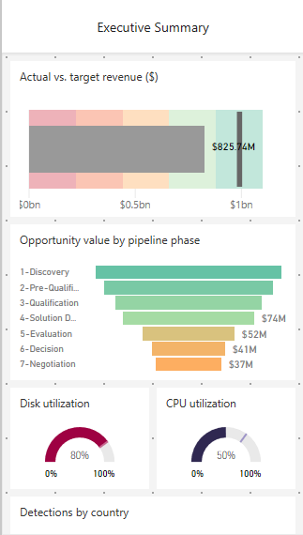
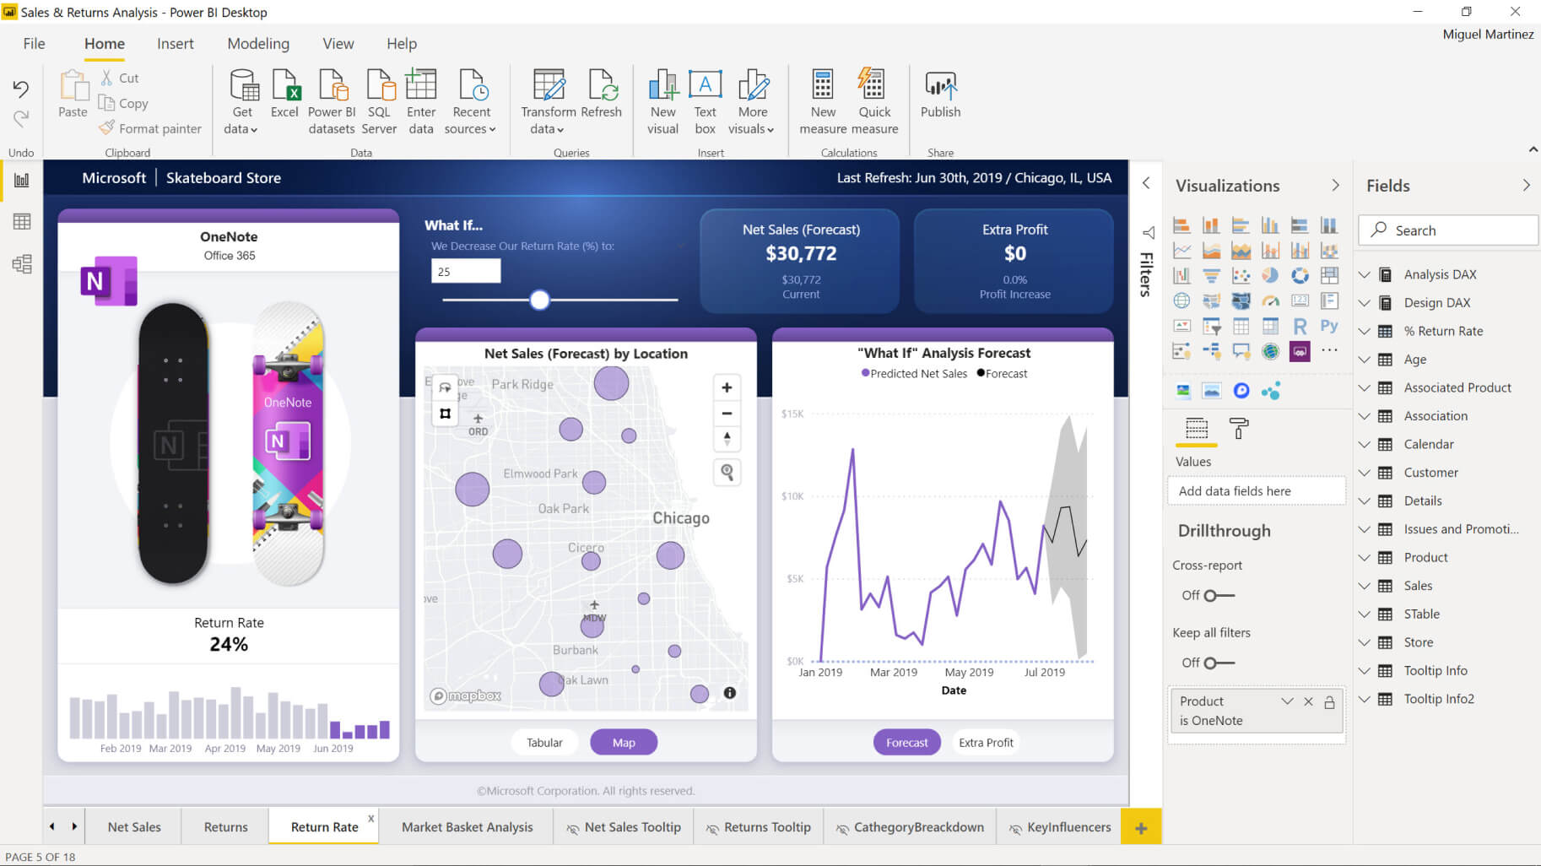
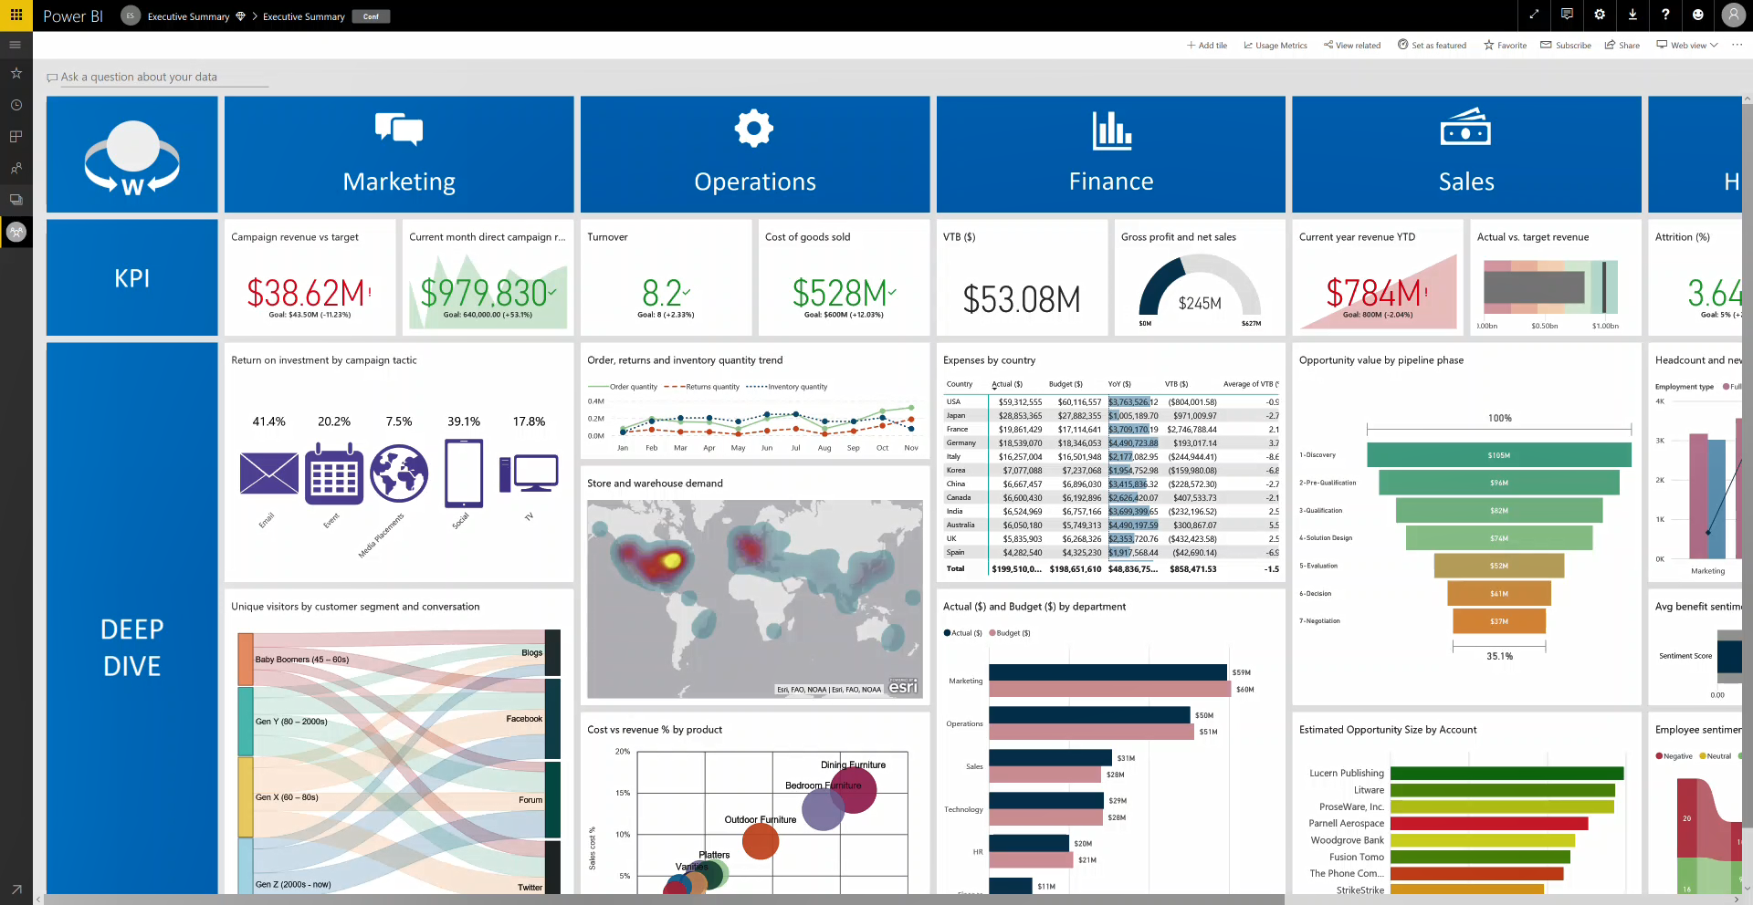
Introduction to Power BI
Power BI: A collection of software, services, apps, and connectors.
Notes:
Microsoft Power BI is a collection of software services, apps, and connectors that work together to turn your unrelated sources of data into coherent, visually immersive, and interactive insights. Whether your data is a simple Microsoft Excel workbook, or a collection of cloud-based and on-premises hybrid data warehouses, Power BI lets you easily connect to your data sources, visualize (or discover) what's important, and share that with anyone or everyone you want.
Desktop: A free application you install on your local computer that lets you connect to, transform, and visualize your data.
Service: A SaaS service which brings together dashboards, workspaces, reports, and datasets for keeping a finger on the pulse of your business.
Mobile: Connect to and interact with your cloud and on-premises data. You create reports in Power BI Desktop. You create dashboards, and view dashboards and reports in the Power BI report service. You view on-premises Power BI reports on Power BI Report Server. All these reports and dashboards are available in the Power BI mobile apps, whether they're on premises or in the cloud.
How you use Power BI might depend on your role on a project or a team. And other people, in other roles, might use Power BI differently, which is just fine.
The flow of work in Power BI
A common flow of work in Power BI begins in Power BI Desktop, where a report is created. That report is then published to the Power BI service and finally shared, so that users of Power BI Mobile apps can consume the information.

Slide 14


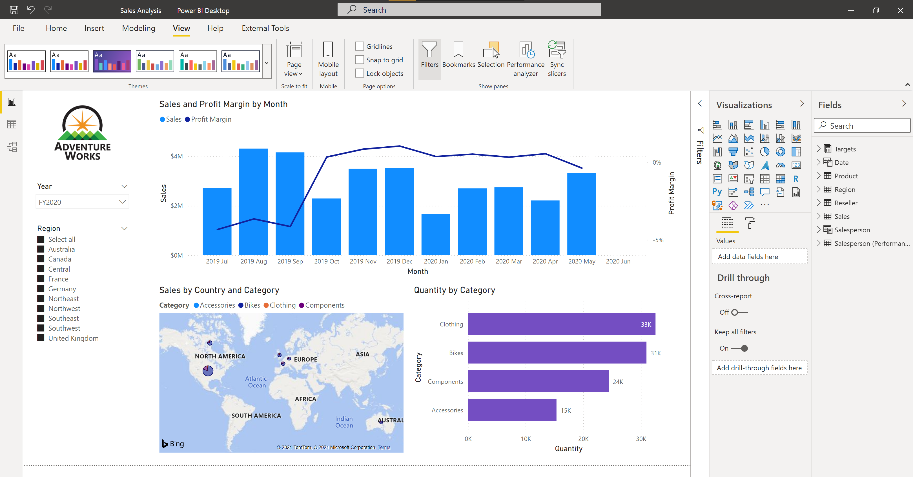




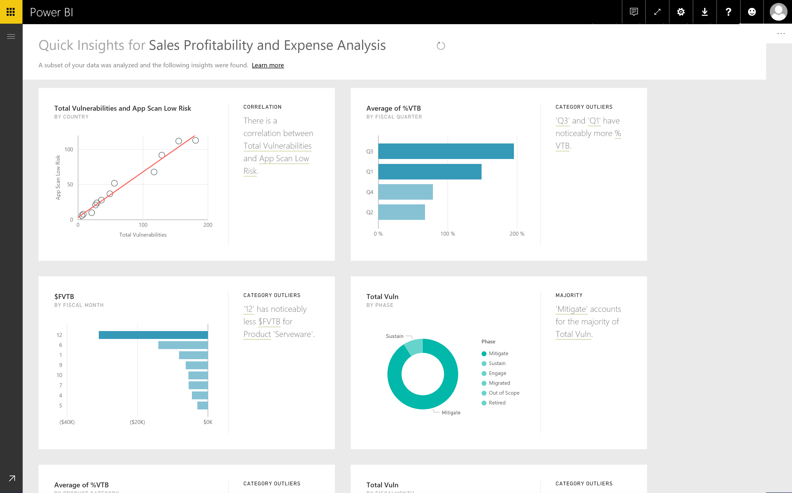
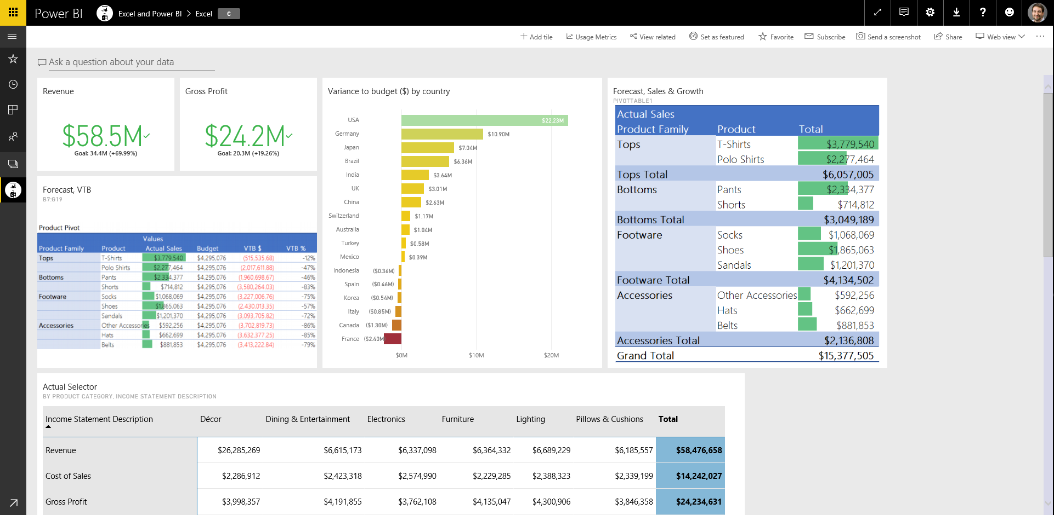
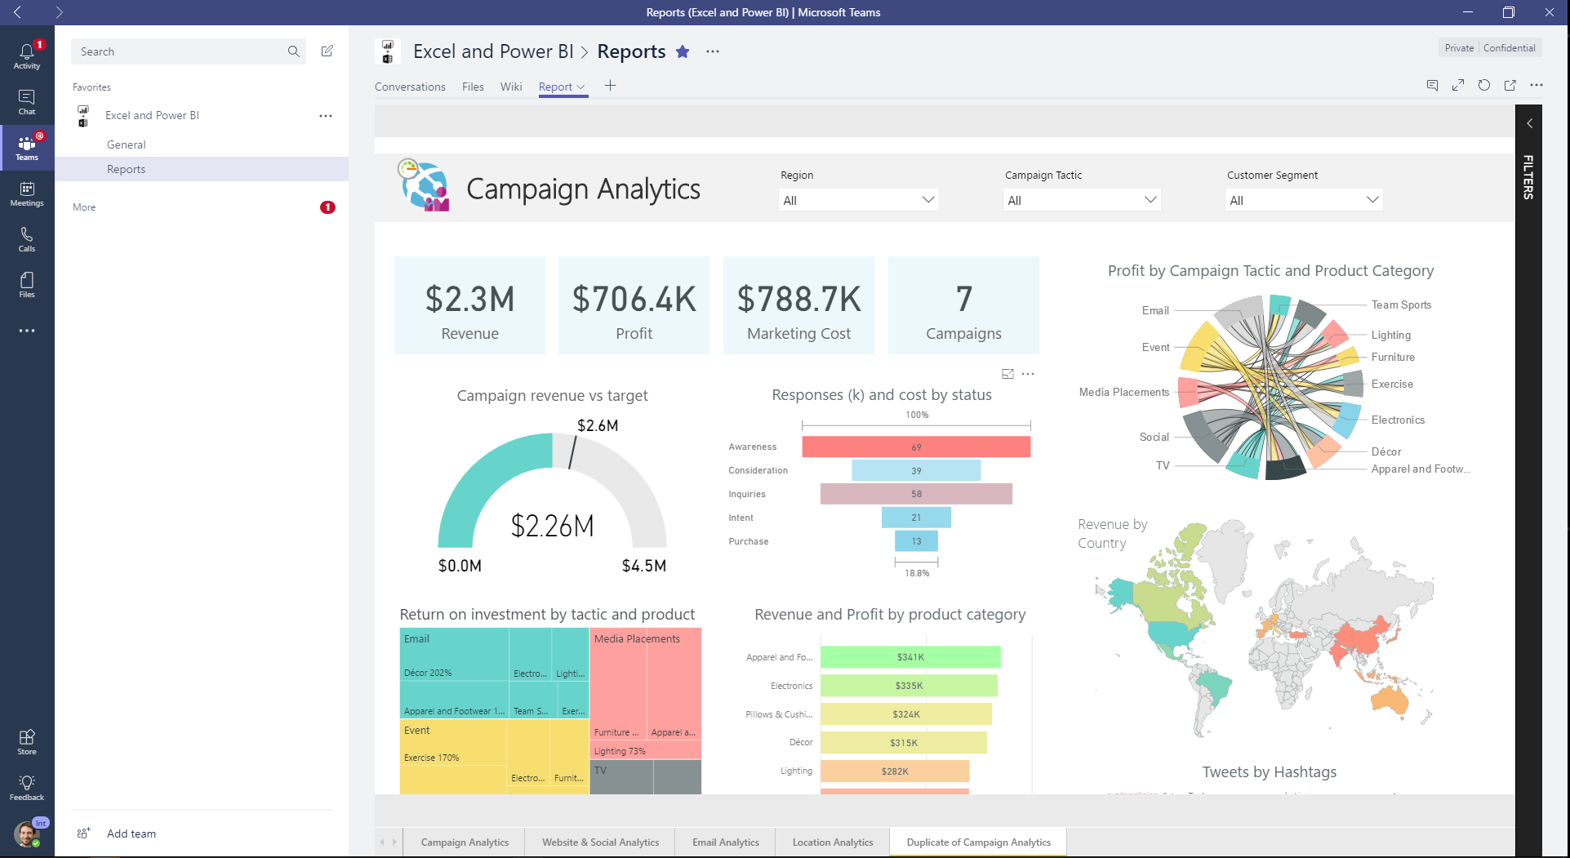
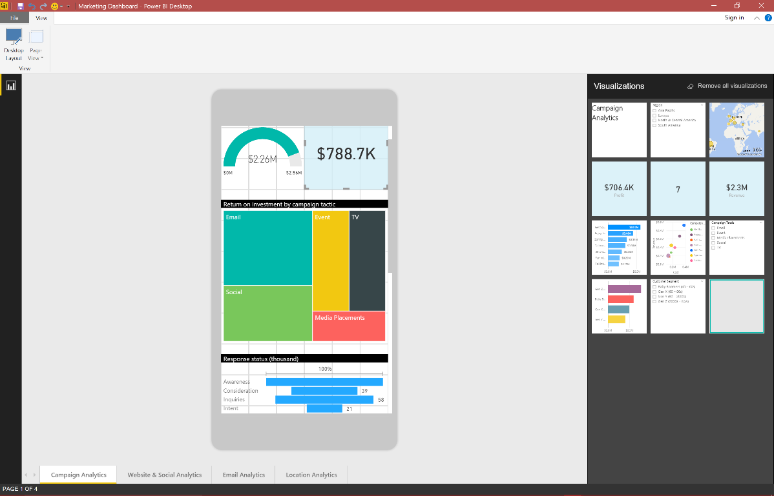

Use Power BI
Notes:
Now that we've introduced the basics of Microsoft Power BI, let's jump into some hands-on experiences and a guided tour.
The activities and analyses that you'll learn with Power BI generally follow a common flow. The common flow of activity looks like this:
Bring data into Power BI Desktop, and create a report.
Publish to the Power BI service, where you can create new visualizations or build dashboards.
Share dashboards with others, especially people who are on the go.
View and interact with shared dashboards and reports in Power BI Mobile apps.
As mentioned earlier, you might spend all your time in the Power BI service, viewing visuals and reports that have been created by others. And that's fine. Someone else on your team might spend their time in Power BI Desktop, which is fine too. To help you understand the full continuum of Power BI and what it can do, we'll show you all of it. Then you can decide how to use it to your best advantage.
So, let's jump in and step through the experience. Your first order of business is to learn the basic building blocks of Power BI, which will provide a solid basis for turning data into cool reports and visuals.

Slide 15
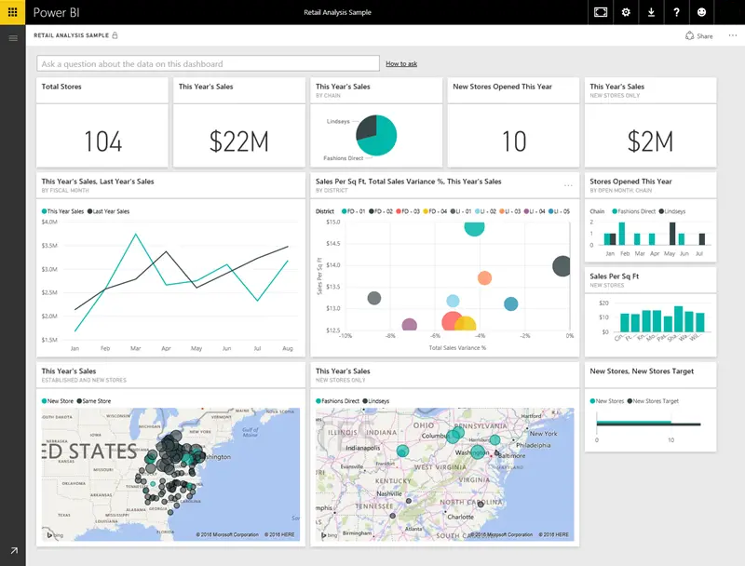
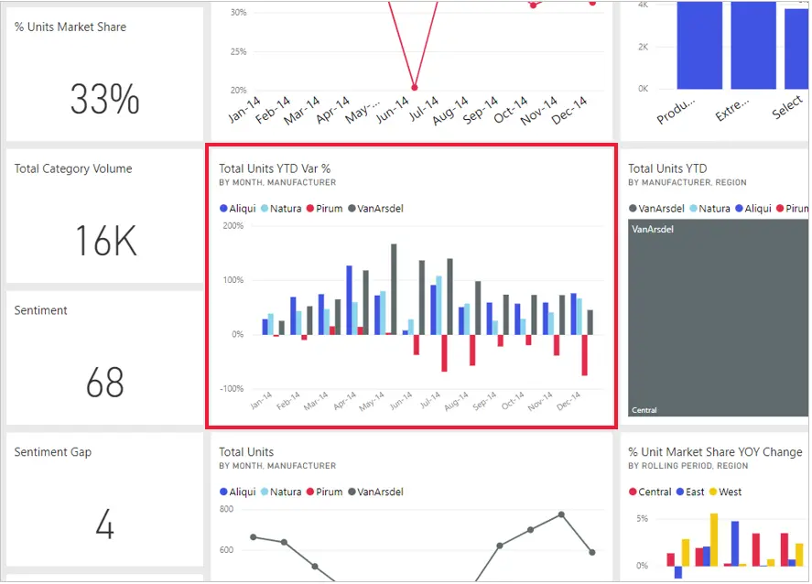
Building Blocks of Power BI
Notes:
Everything you do in Microsoft Power BI can be broken down into a few basic building blocks. After you understand these building blocks, you can expand on each of them and begin creating elaborate and complex reports. Let’s explore the basic building blocks, discuss some simple things that can be built with them, and then get a glimpse into how complex things can also be created.
Visualizations: Sometimes also referred to as a visual, it is a visual representation of data, like a chart, a color-coded map, or other interesting things you can create to represent your data visually. Power BI has all sorts of visualization types, and more are coming all the time. The following image shows a collection of different visualizations that were created in the Power BI service.
<CLICK>
Datasets: A collection of data from a combination of many different sources which you can filter and combine to provide a unique collection of data (a dataset) used to create visualizations.
<CLICK>
Reports: A collection of visualizations that appear together on one or more pages.
<CLICK>
Dashboards: A collection of visuals from a single page that you can share with others. Often, it's a selected group of visuals that provide quick insight into the data or story you're trying to present.
<CLICK>
Tiles: A single visualization on a report or a dashboard. It's the rectangular box that holds an individual visual.

Slide 16
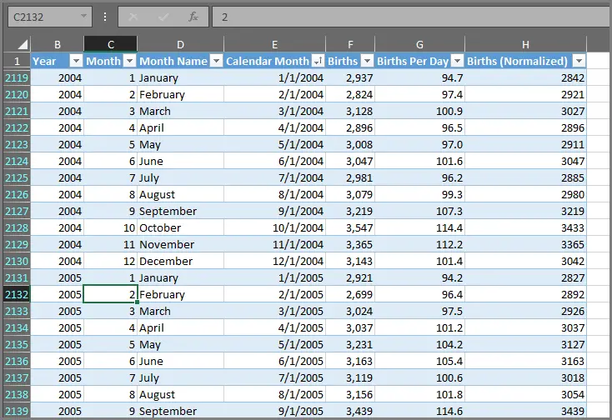
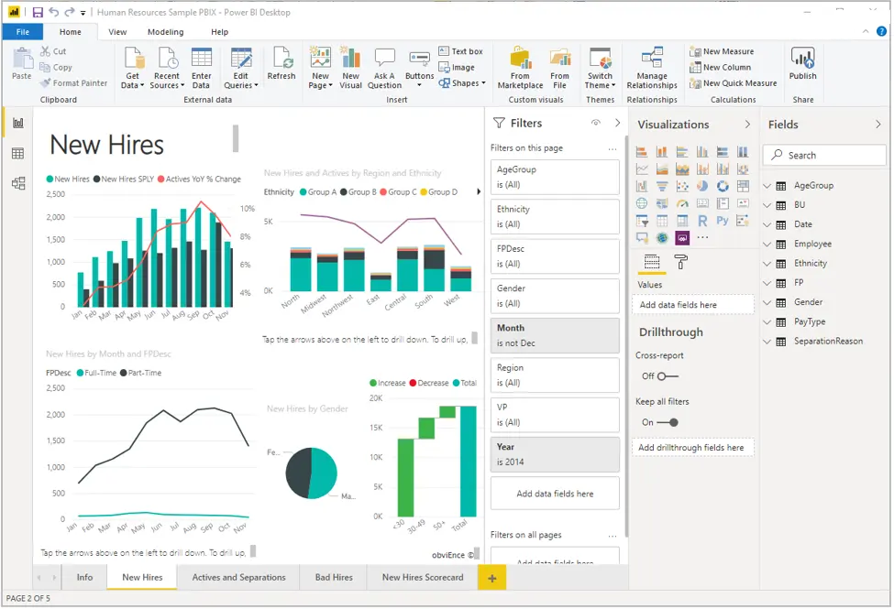
Building Blocks of Power BI
Notes:
Everything you do in Microsoft Power BI can be broken down into a few basic building blocks. After you understand these building blocks, you can expand on each of them and begin creating elaborate and complex reports. Let’s explore the basic building blocks, discuss some simple things that can be built with them, and then get a glimpse into how complex things can also be created.
Visualizations: Sometimes also referred to as a visual, it is a visual representation of data, like a chart, a color-coded map, or other interesting things you can create to represent your data visually. Power BI has all sorts of visualization types, and more are coming all the time. The following image shows a collection of different visualizations that were created in the Power BI service.
<CLICK>
Datasets: A collection of data from a combination of many different sources which you can filter and combine to provide a unique collection of data (a dataset) used to create visualizations.
<CLICK>
Reports: A collection of visualizations that appear together on one or more pages.
<CLICK>
Dashboards: A collection of visuals from a single page that you can share with others. Often, it's a selected group of visuals that provide quick insight into the data or story you're trying to present.
<CLICK>
Tiles: A single visualization on a report or a dashboard. It's the rectangular box that holds an individual visual.

Slide 17
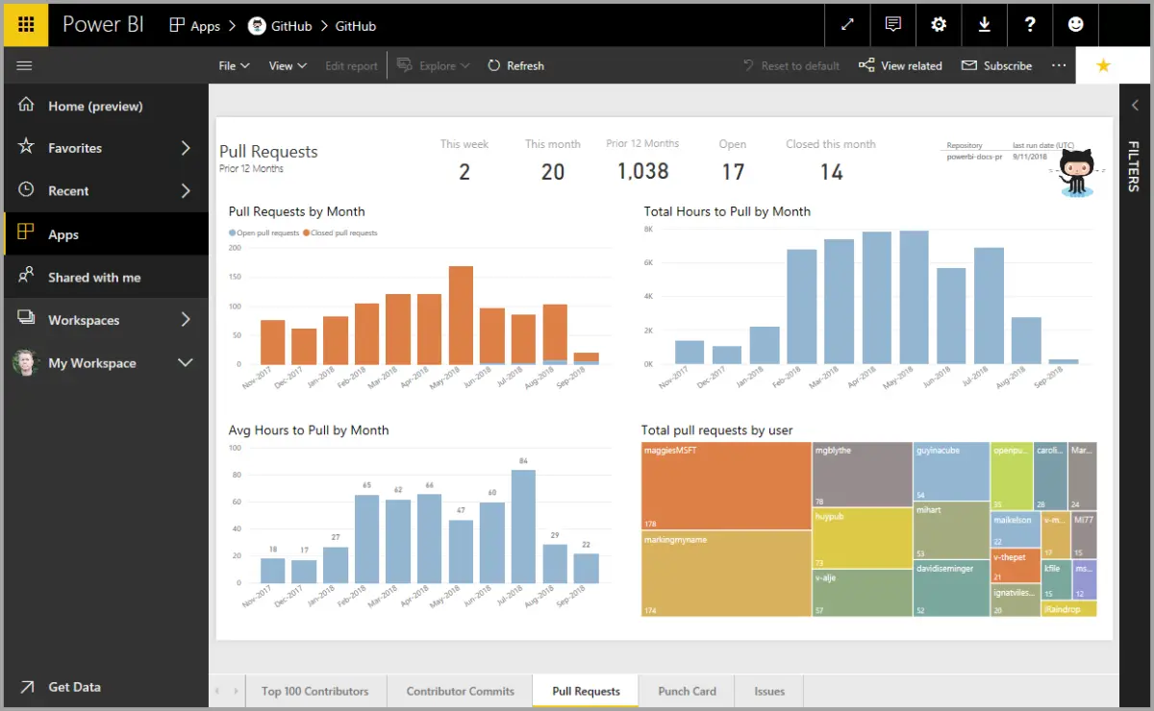
Touring and Using Power BI
Notes:
The common flow of work in Microsoft Power BI is to create a report in Power BI Desktop, publish it to the Power BI service, and then share it with others, so that they can view it in the service or on a mobile app.
But because some people begin in the Power BI service, let’s get an overview of that first, and learn about an easy and popular way to quickly create visuals in Power BI: apps.
An app is a collection of preset, ready-made visuals and reports that are shared with an entire organization. Using an app is like microwaving a TV dinner or ordering a fast-food value meal: you just have to press a few buttons or make a few comments, and you're quickly served a collection of entrees designed to go together, all presented in a tidy, ready-to-consume package.
The canvas (the area in the center of the Power BI service) shows you the available sources of data in the Power BI service.
There are apps for all sorts of online services.
Update data in the Power BI service
You can also choose to update the dataset for an app, or other data that you use in Power BI.

Slide 18
Review Questions
Q01 – What are the building blocks of Power BI?
A01 – Visualizations, Datasets, Reports, Dashboards, and Tiles
Q02 – What is the common flow of activity in Power BI?
A02 – Bring data into Power BI Desktop and create a report, share it to the Power BI service, view and interact with reports and dashboards.
Q03 – A collection of ready-made visuals, pre-arranged in dashboards and reports is called what?
A03 – An App

Slide 19
Module Overview
We covered the following concepts:
Data Analysis
How to get started with Power BI
Notes:
In this module we discussed:
Data Analysis
How to get started with Power BI

Slide 20
References
PL-300 Discover data analysis
https://docs.microsoft.com/en-us/learn/modules/data-analytics-microsoft/
PL-300 Get started building with Power BI
https://docs.microsoft.com/en-us/learn/modules/get-started-with-power-bi/

Slide 21
Closing slide

